Slide 1
Design Patterns 2
Waqar Yar

Slide 2
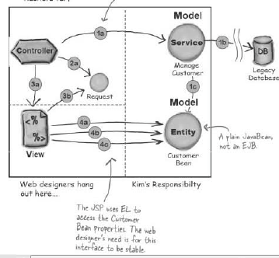
Typical MVC Pattern

Slide 3
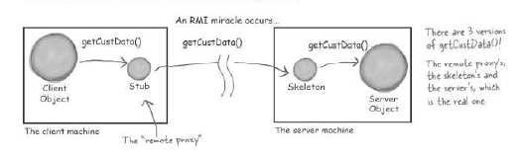
RMI for Web Applications

Slide 4
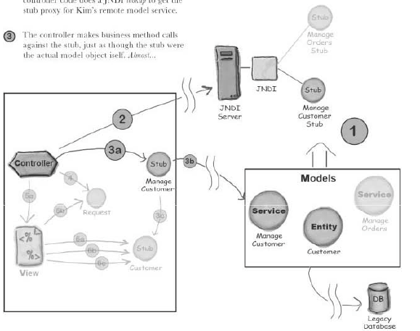
Implementation of RMI

Slide 5
Two problems in this architecture
Complex JNDI lookup
We need to hide the remote object access complexity.

Slide 6
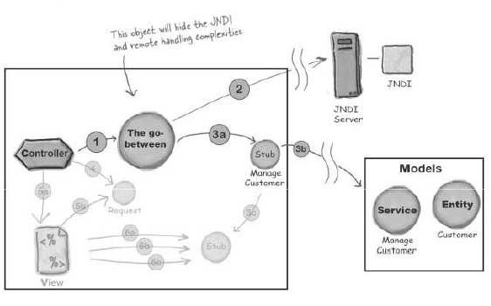
Solution.

Slide 7
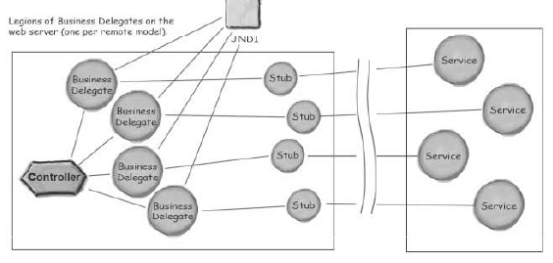
Business Delegate

Slide 8
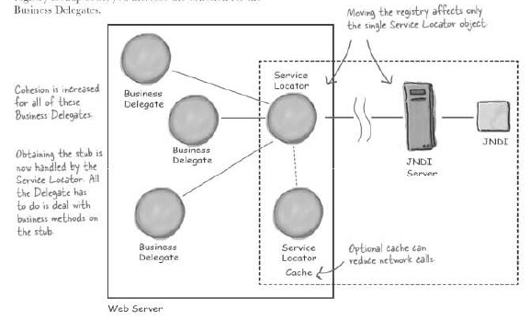
Remove Duplicate by using Service Locator.

Slide 9
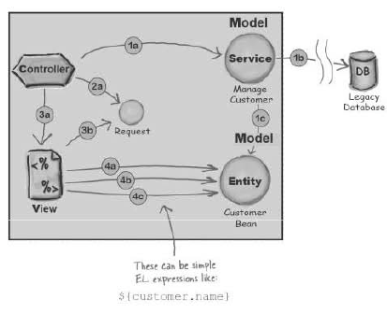
Single Server MVC

Slide 10
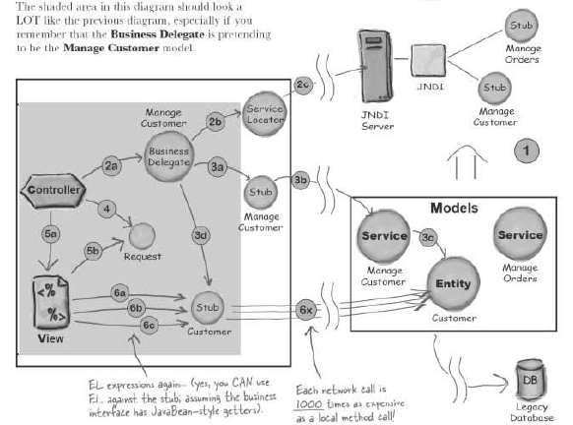
Multiple Servers MVC

Slide 11
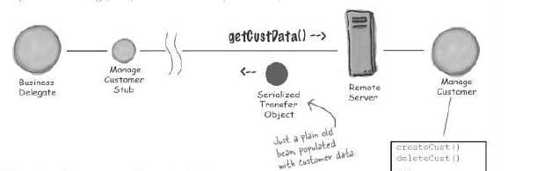
Data Transfer Object - DTO

Slide 12
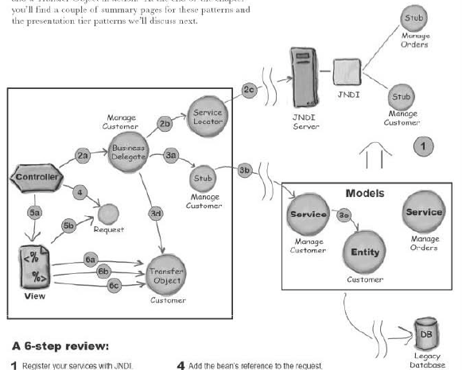
Final Multi-server Architecture.

Slide 13
Final Exam Pattern.
Design Questions (Architectures)-appox 40%
Multiple Choice –appox 20%
Coding small parts (Servlets, Ajax, JavaScript) –appox 20%
Questions on concepts. –appox 20%
Chapters: 1 to 7,12 and 14
Java Script
XML and Web Services

